Slide 1

A Semantic Annotation System for Web of Things
Du Sicong
BUPT number : 2013213144
QM number : 130801256
Project No. : RC_3144
Notes:
注意： 想要 在此幻灯片上使用不同的 图像？请选择 该图片并将其删除。 现在， 在占位符中单击“图片”图标以便插入自己的图像。

Slide 2
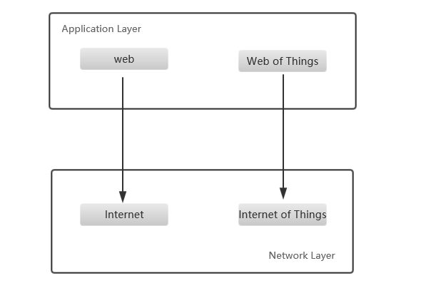
Web of Things
Reuse web pattern and protocols
Simplify the application creation
Make things part of WWW

Slide 3
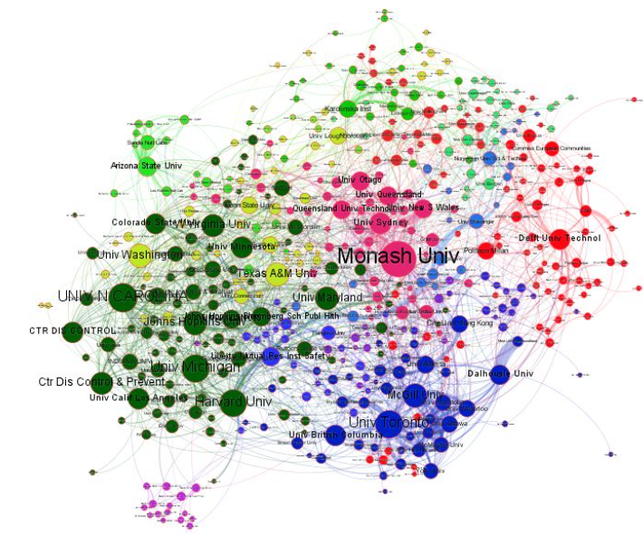
Semantic annotation
Metadata
Construct a knowledge graph
Machine understandable

Slide 4
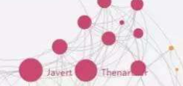
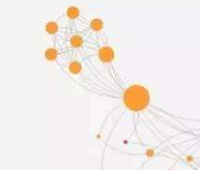
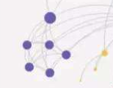
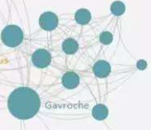
Present status
Domain specific knowledge base
Isolation among WoT application

Slide 5
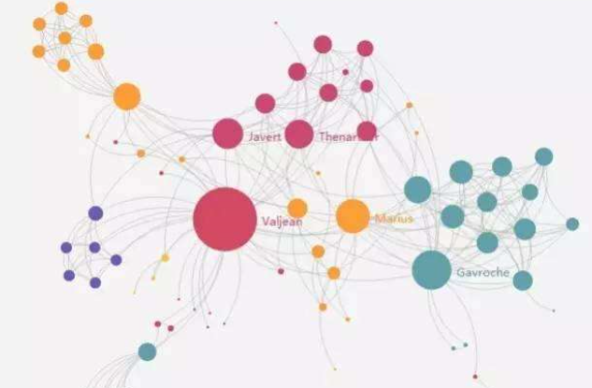
Motivation
Connect them together
Growing body
Ambiguity : different definition but the same meaning
Take a global domain independent knowledge base as medium

Slide 6

Semantic annotation system
Manual
Automatic
generate
Networked knowledge infrastructure

Slide 7

图片与题注版式
题注

